Slide 1

Home Learning Activity
….things to do while school is closed and how they really work!

Slide 2



School is closed!
….but we can still go outside

Slide 3
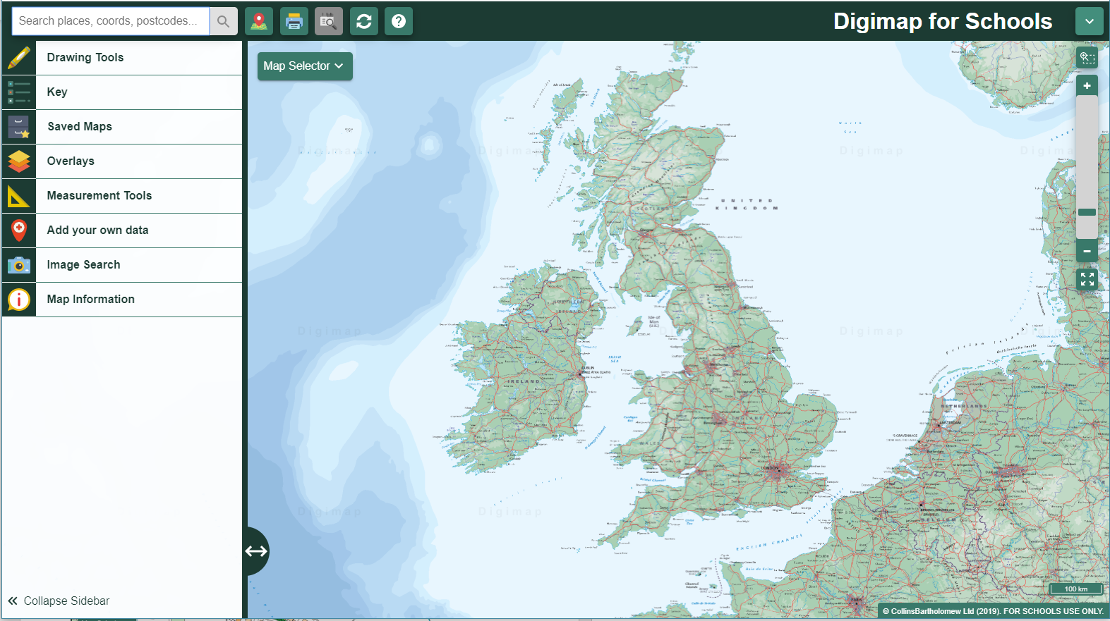
Use Digimap for Schools for your daily walk

Slide 4
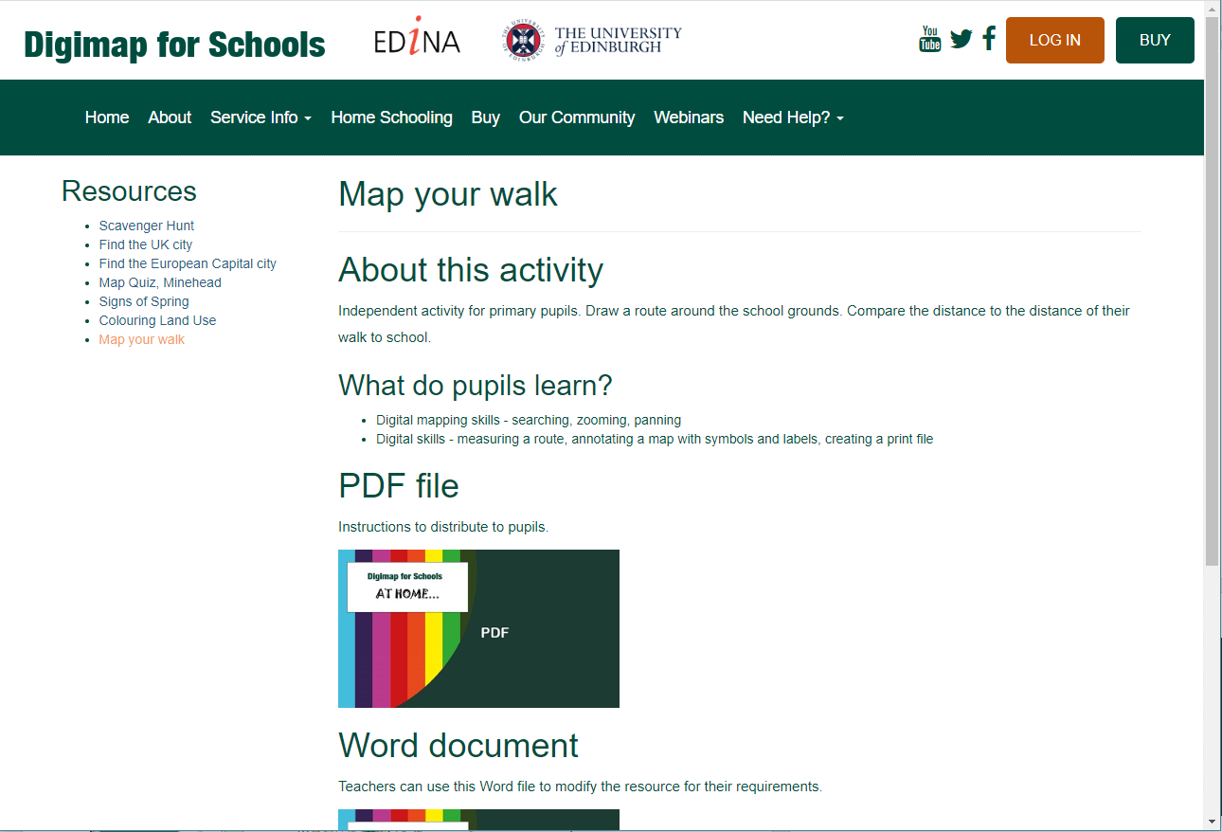
What we did…
We looked at the Digimap for Schools free resources and found one that measures distances

Slide 5
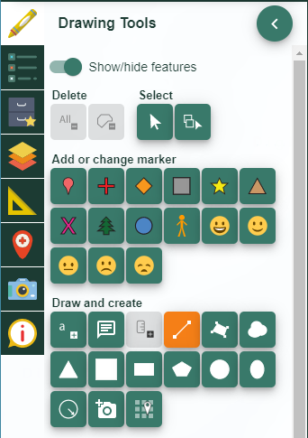
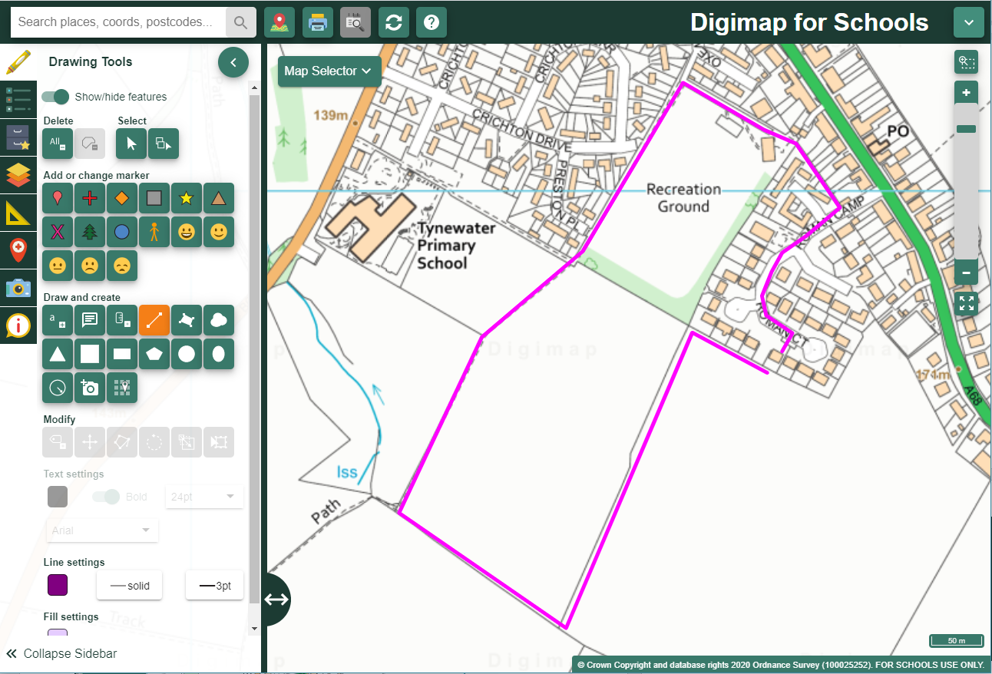
What we did next…
We mapped out our route using the line drawing tool
Here is our route…

Slide 6
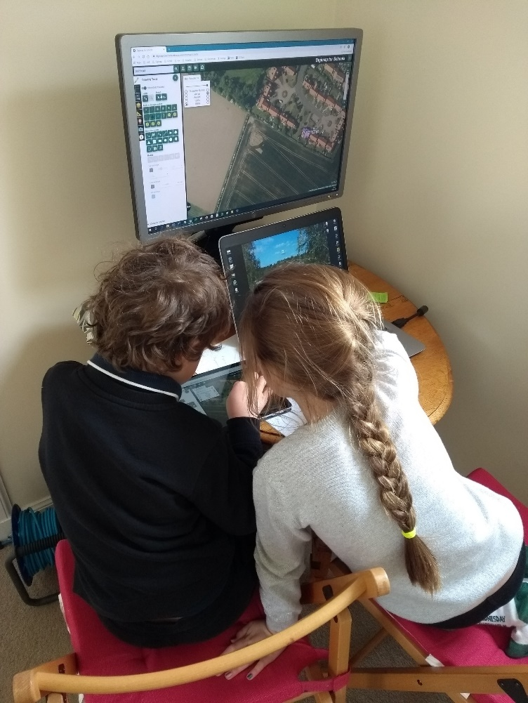
Hard at work…

Slide 7
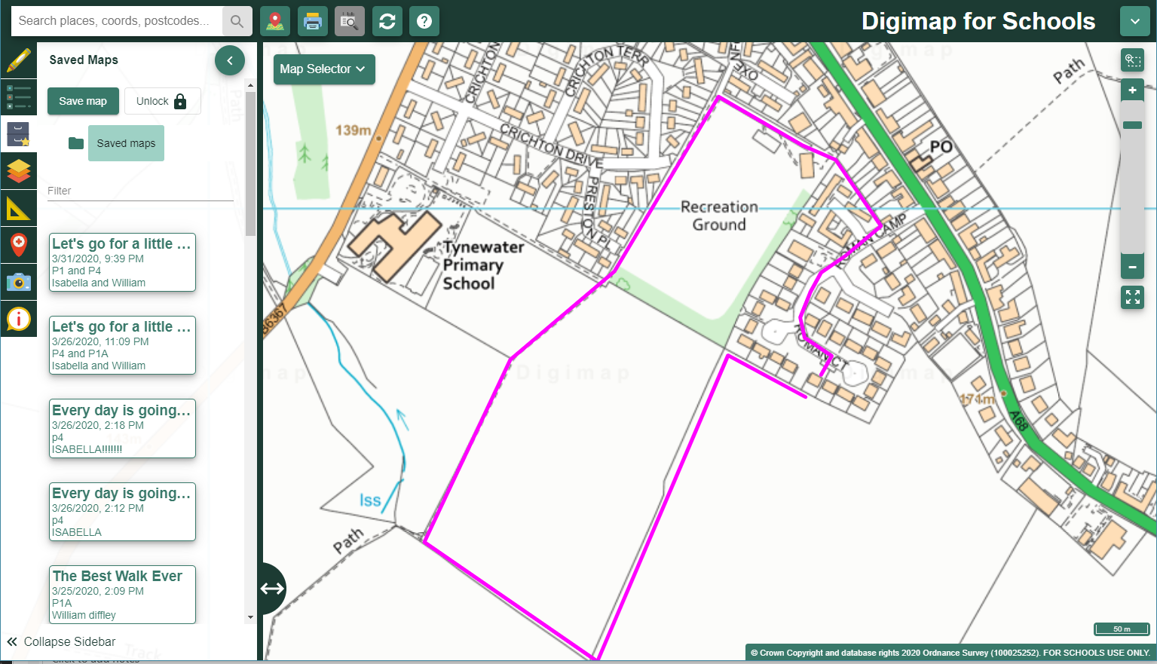
Save the map and print it

Slide 8
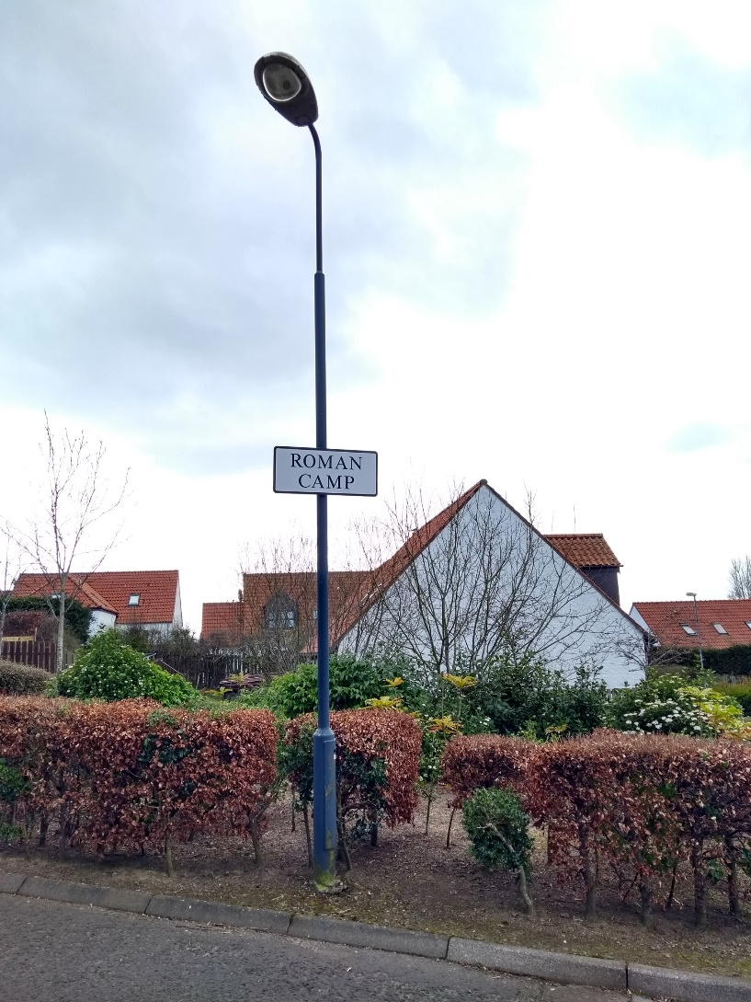
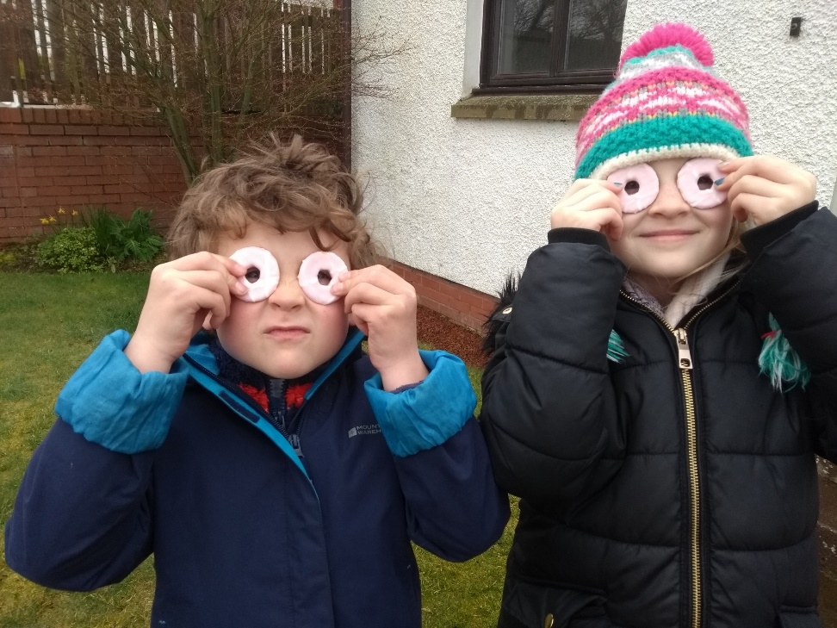
Off we go…
We took lots of photographs

Slide 9
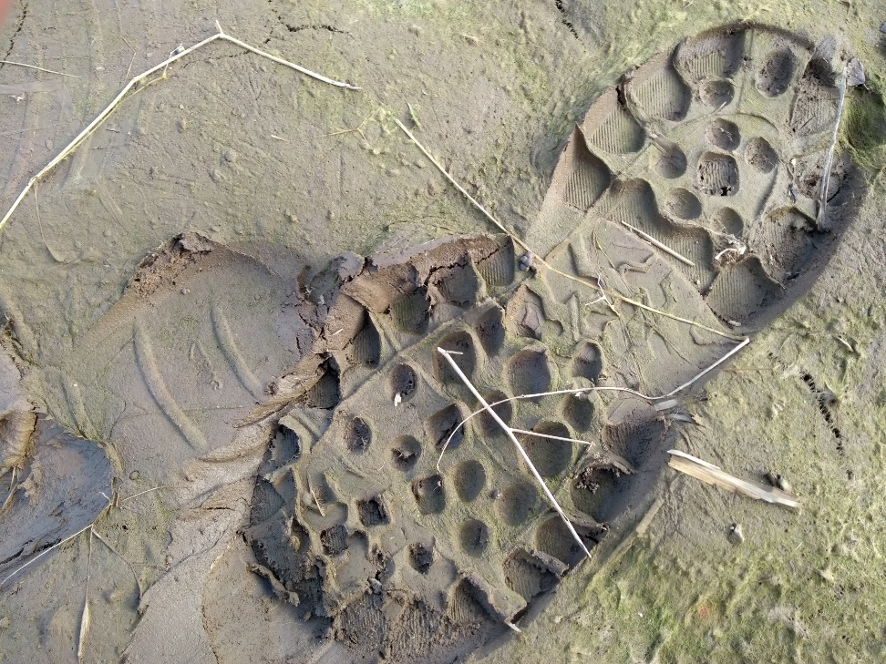
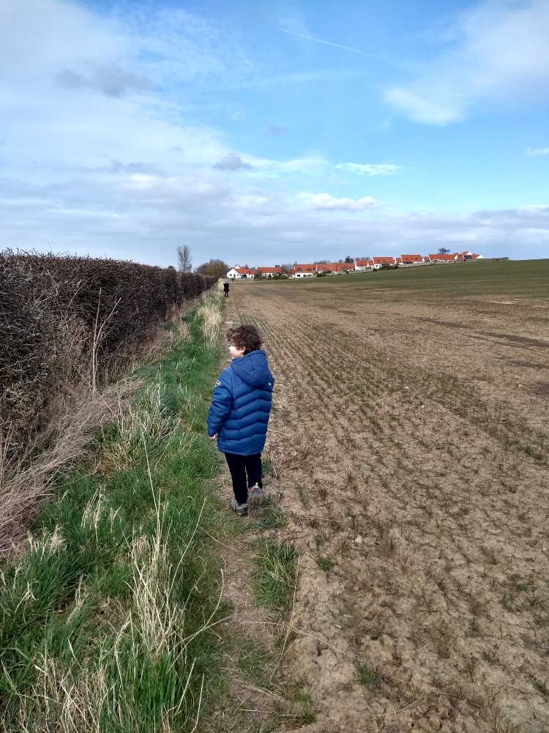
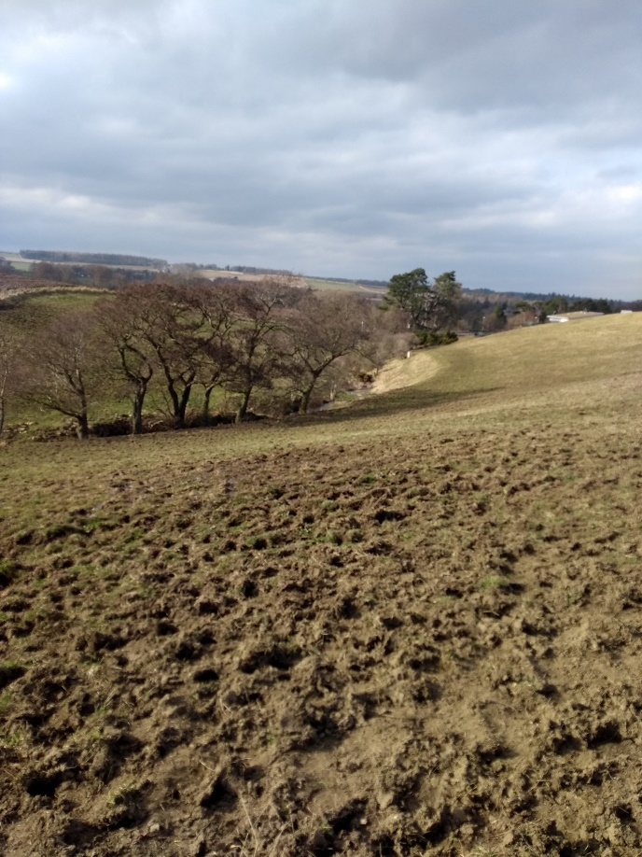
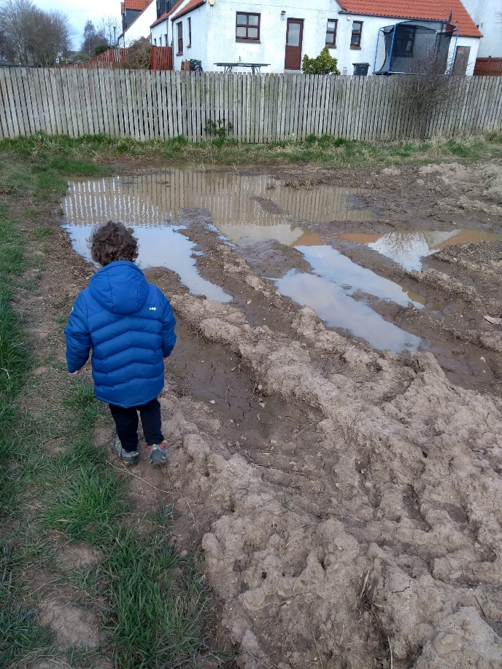
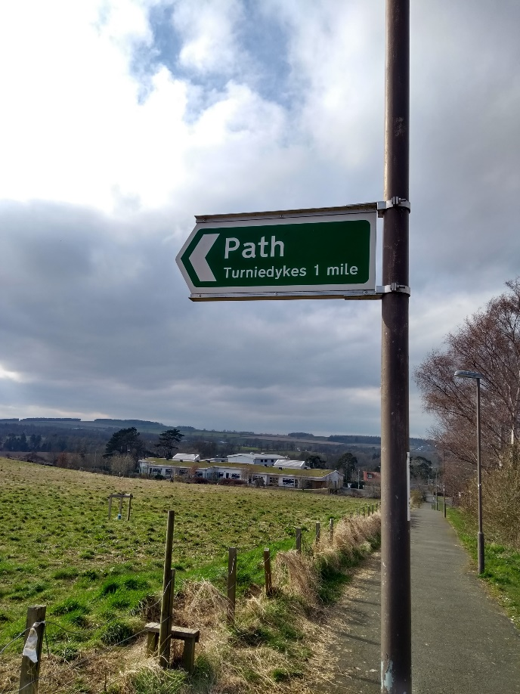
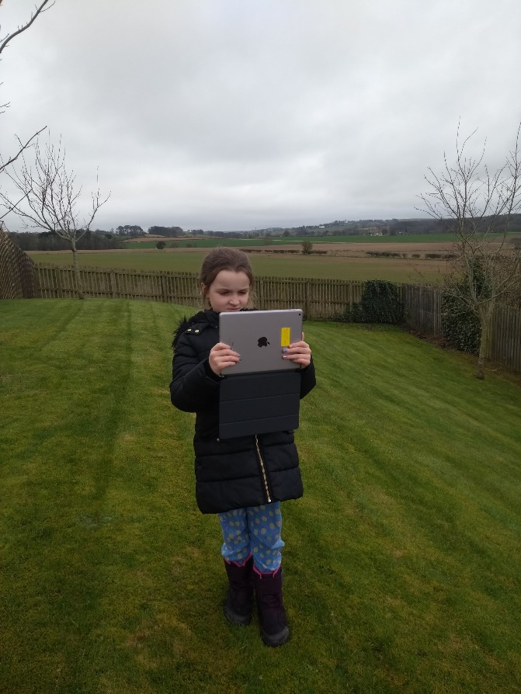


Slide 10
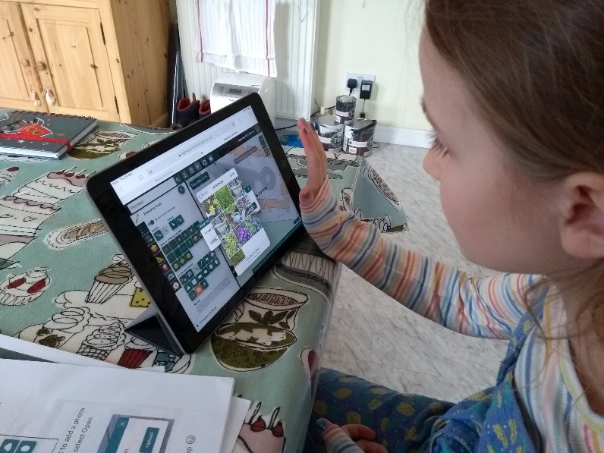
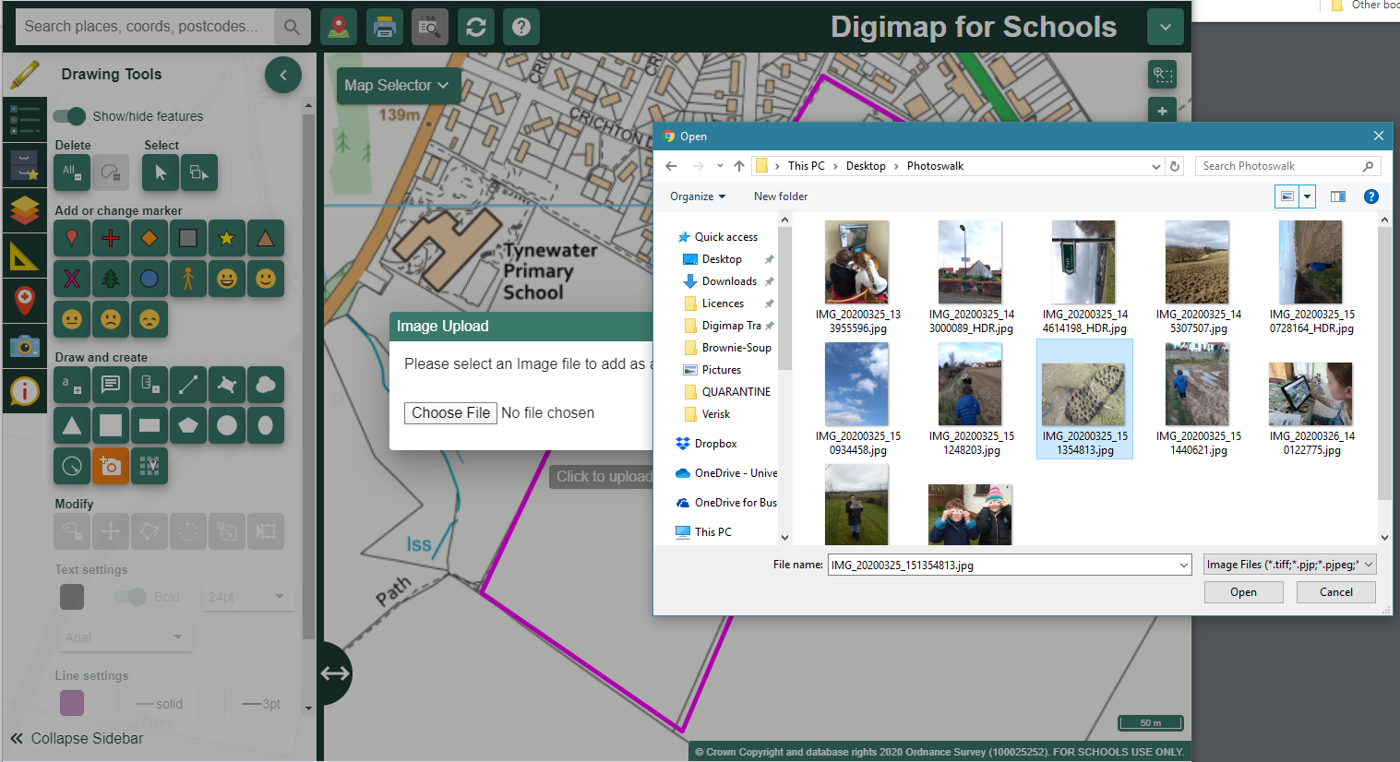
When we got home…
We added the pictures to our map

Slide 11
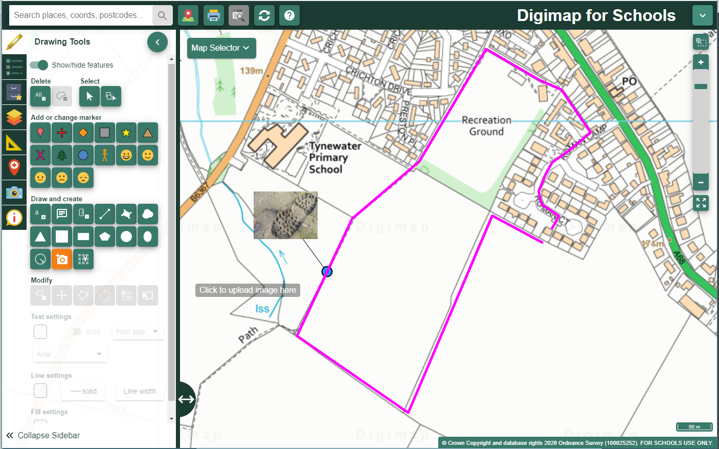
This is where we found the muddy footprint

Slide 12
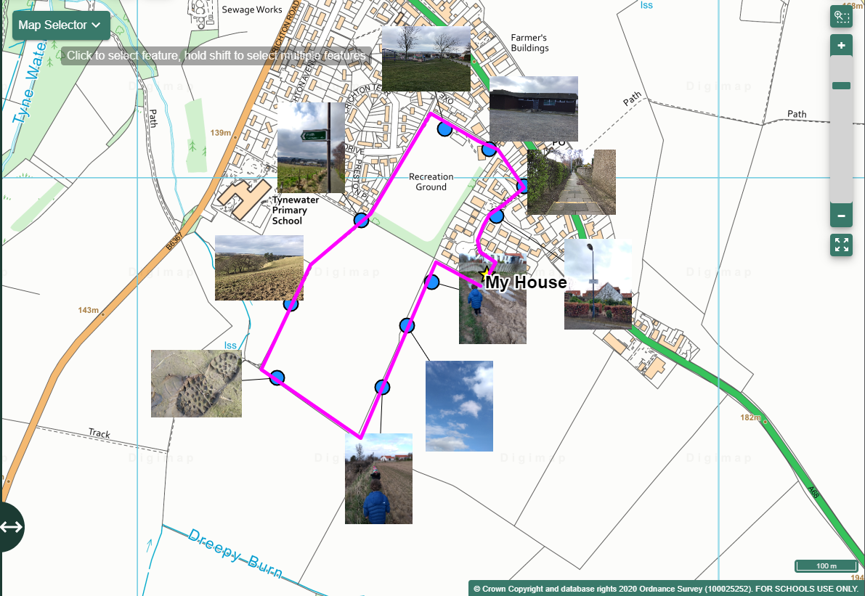
We took lots of pictures!

Slide 13
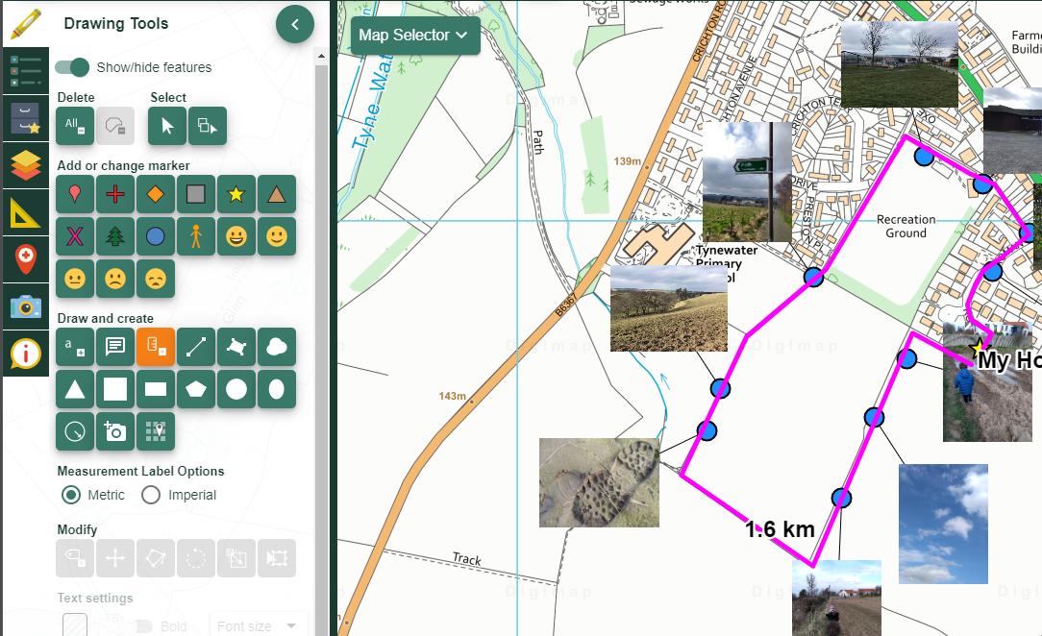
Finishing touches
We used the Measurement Label to add the distance we walked to the line we had drawn

Slide 14
What did we learn
How to read a map and follow a route
How to draw a route using Digimap
How to add photographs to our map
How to label the route with the distance
That there are lots of things to see and do on what we thought was a “boring walk” ☺

Slide 15
But we have 13 weeks!
What next?

Slide 16
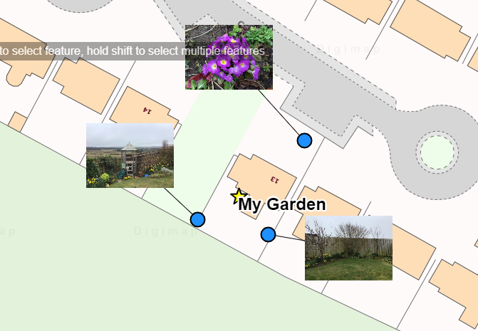
Take a look at your garden

Slide 17
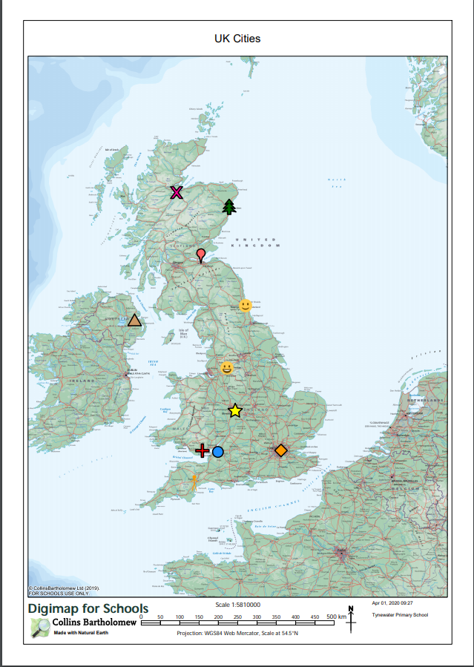
How well do you know places?
Use a different symbol to mark places on a map
Print it out
Ask the children to use Digimap for Schools to identify the places marked
This one has UK cities, but you could use any place, and make a map at any scale.
Children could even set this challenge for each other.

Slide 18
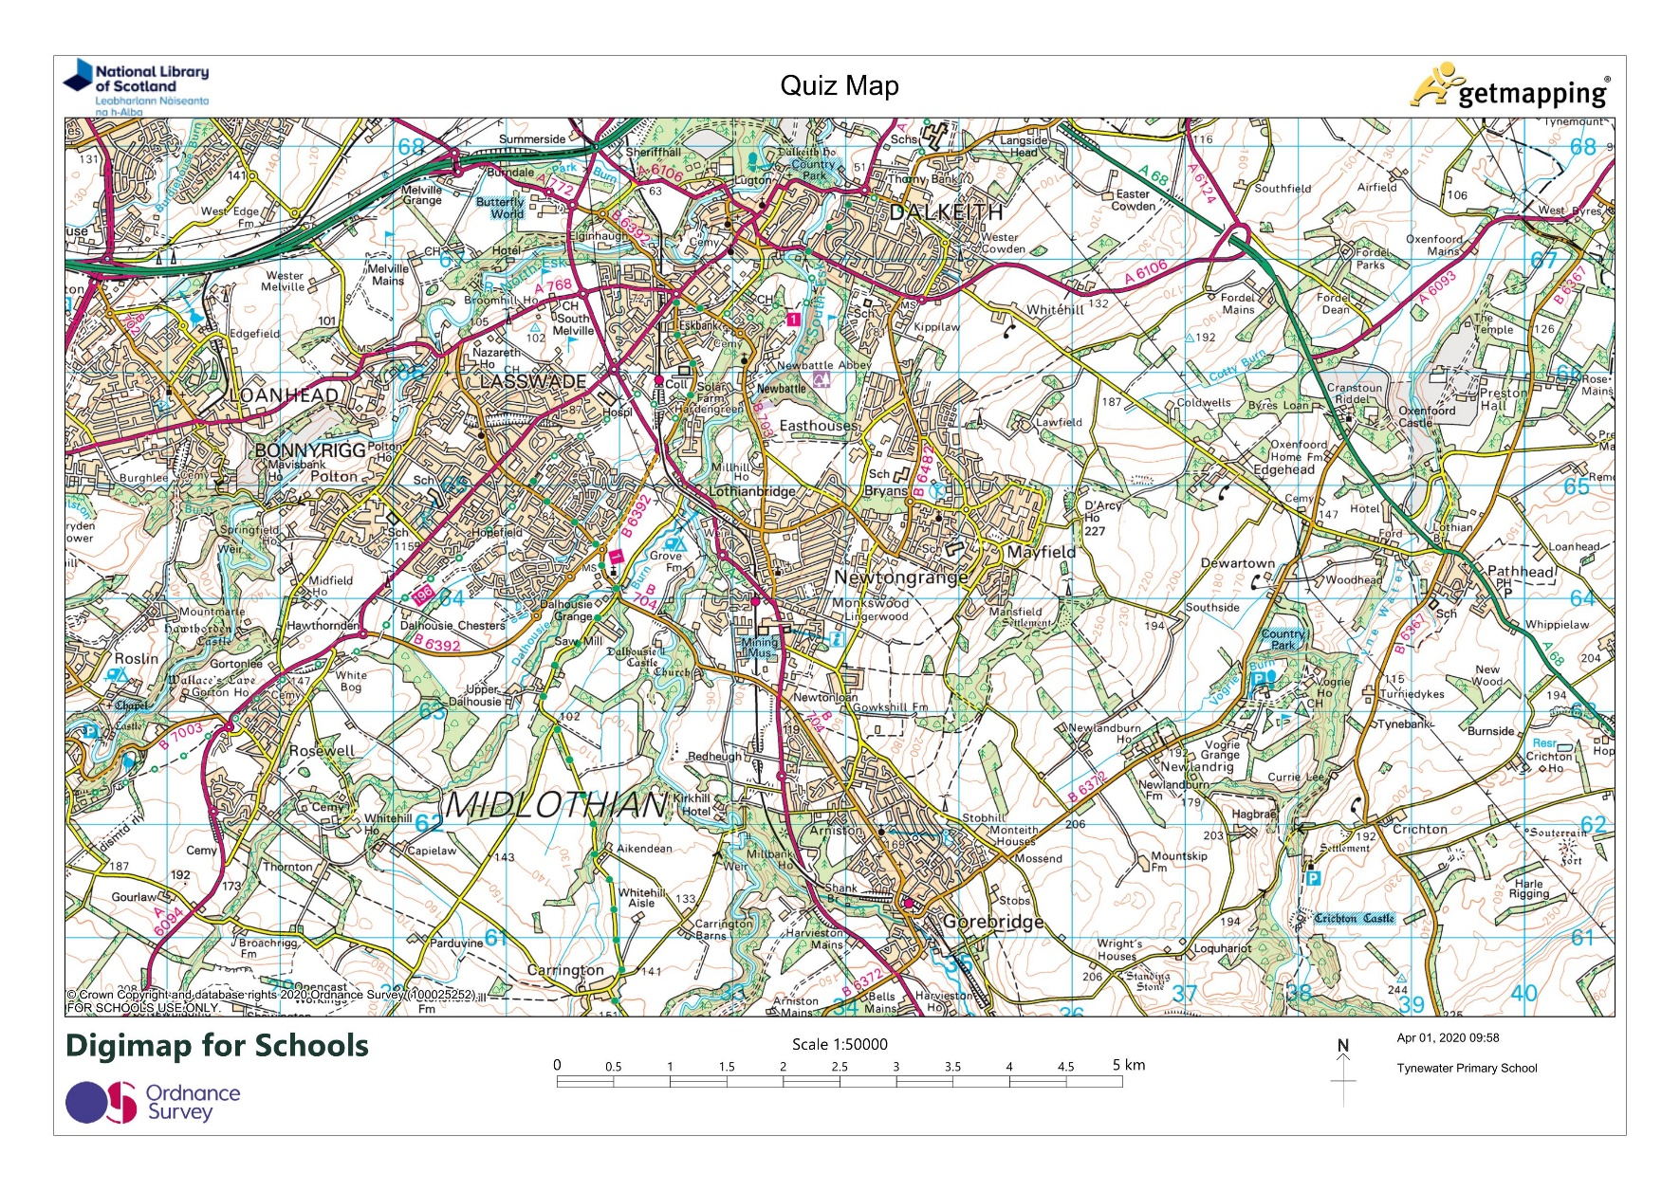
Write a Quiz

Slide 19
Invent questions
Some examples:
  How many railway stations can you find?
  How many campsites are there?
  Find the numbers of two A roads
  Find 3 places where people go for fun
  What’s the highest point on the map and how high is it?
  Find as many schools as you can
There is an example quiz about Minehead on the Digimap for Schools website

Slide 20
If all else is lost…
My children have enjoyed “messing around” with Digimap for Schools
Aerial photographs, 1950s and 1890s maps, road maps, all scales
Let them play with it

Slide 21
Home Schooling resources:
https://digimapforschools.edina.ac.uk/resources/scavengerhunt/
Youtube:
https://www.youtube.com/user/digimapforschools
Twitter:
https://twitter.com/Digimap4Schools

